Slide 1
SQL Concurrency

Slide 2
SQL Concurrency
Concurrency
Understanding Isolation Levels
Concurrency side effects
Read uncommitted
Read committed
Repeatable read
Snapshot
Serializable

Slide 3
Concurrency
Concurrency can be defined as the ability of multiple processes to access or change shared data at the same time.

Slide 4
Understanding isolation levels
Transactions specify an isolation level that:
Defines the degree to which one transaction must be isolated from resource or data modifications made by other transactions.
Described in terms of which concurrency side effects are allowed.

Slide 5
Understanding isolation levels
Whether locks are taken when data is read, and what type of locks are requested.
How long the read locks are held.
Whether a read operation referencing rows modified by another transaction:
Block until the exclusive lock on the row is freed.
Retrieve the committed version of the row that existed at the time the statement or transaction started.
Read the uncommitted data modification.

Slide 6
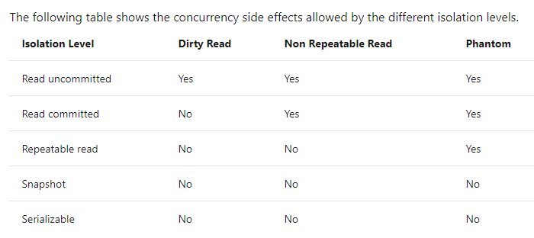
Understanding isolation levels

Slide 7
Read uncommitted
Specifies that statements can read rows that have been modified by other transactions but not yet committed.

Slide 8
Read committed
Specifies that statements can read rows that have been modified by other transactions but not yet committed.

Slide 9
Repeatable read
Specifies that statements cannot read data that has been modified but not yet committed by other transactions.
And that no other transactions can modify data that has been read by the current transaction until the current transaction completes.

Slide 10
Snapshot
Specifies that data read by any statement in a transaction will be the transactionally consistent version of the data that existed(committed) at the start of the transaction.
The ALLOW_SNAPSHOT_ISOLATION database option must be set to ON before you can start a transaction that uses the SNAPSHOT isolation level.

Slide 11
Serializable
Statements cannot read data that has been modified but not yet committed by other transactions. (like read committed, prevent dirty read)
No other transactions can modify data that has been read by the current transaction until the current transaction completes. (like repeatable read)
Other transactions cannot insert new rows with key values that would fall in the range of keys read by any statements in the current transaction until the current transaction completes. (prevent Phantom read)

Slide 12
Serializable
No change is accepted until the transaction is completed

